Slide 1
Do Accountants Increase Economic Activity? By: Elizabeth Blankespoor, Suresh Nallareddy, and Kevin Standridge

Slide 2
Motivating Question
Do accountants matter for social welfare?

Slide 3
Accountants and Social Welfare
Obviously, they matter, or they wouldn’t have survived for centuries across countries (Ball, 2023)
Magnitudes matter
Limited direct evidence
Indirect measures looking at firm level effects
General focus on public firms
Don’t account for spillovers
We won’t be able to provide direct evidence on welfare (utility), but can provide evidence on aggregate economic activity

Slide 4
Research Question
Whether and how accountants affect aggregate economic activity

Slide 5
This Paper
Uses occupational data from over 1.1 million establishments from 2001 to 2022
Examines how changes in the number of accountants affect aggregate measures of welfare
GDP, Employment, Wages, Establishments, etc.
Mechanism: more accountants means, on average, more accounting information

Slide 6
Why Might Accountants Be Good?
Improved capital allocation (i.e., better financial accounting)
Reduced cost of capital (Leuz, 2007)
Improved internal investment decisions (i.e., better managerial accounting)
Improved internal resource allocation (Biddle et al., 2009)
Reduced agency costs (Watts and Zimmerman, 1986)
Better governance (Ge et al., 2017)
Accounting as a public good

Slide 7
Why Might Accountants Be Bad
Hirshleifer (1971) argument – information may redistribute profits among agents but not increase total profits
Stein (1989) argument – managerial myopia
Increased procyclicality with fair value accounting

Slide 8
Endogeneity
Accountants and accounting information will likely increase when the economy is doing better

Slide 9
Solution 1: Bartik Instrument
Usually, friends don’t let friends use instruments
Bartik instrument is the exception
Widely accepted & used technique (Bartik, 1991; Breuer, 2022; Goldsmith-Pinkham et al., 2022)
Has ways to test for both relevance and exclusion restriction
Uses national industry year variation that is exogenous to local conditions
Addresses LOCAL endogeneity
Does not address Industry-year endogeneity

Slide 10
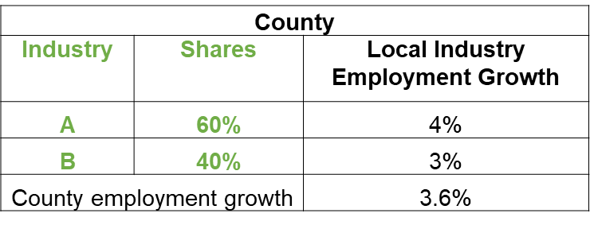
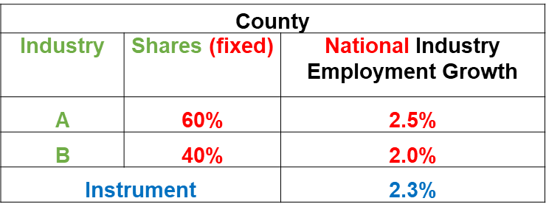
Solution 1: Bartik Instrument
County Accounting Employment growth can be estimated as
Bartik Instrument

Slide 11
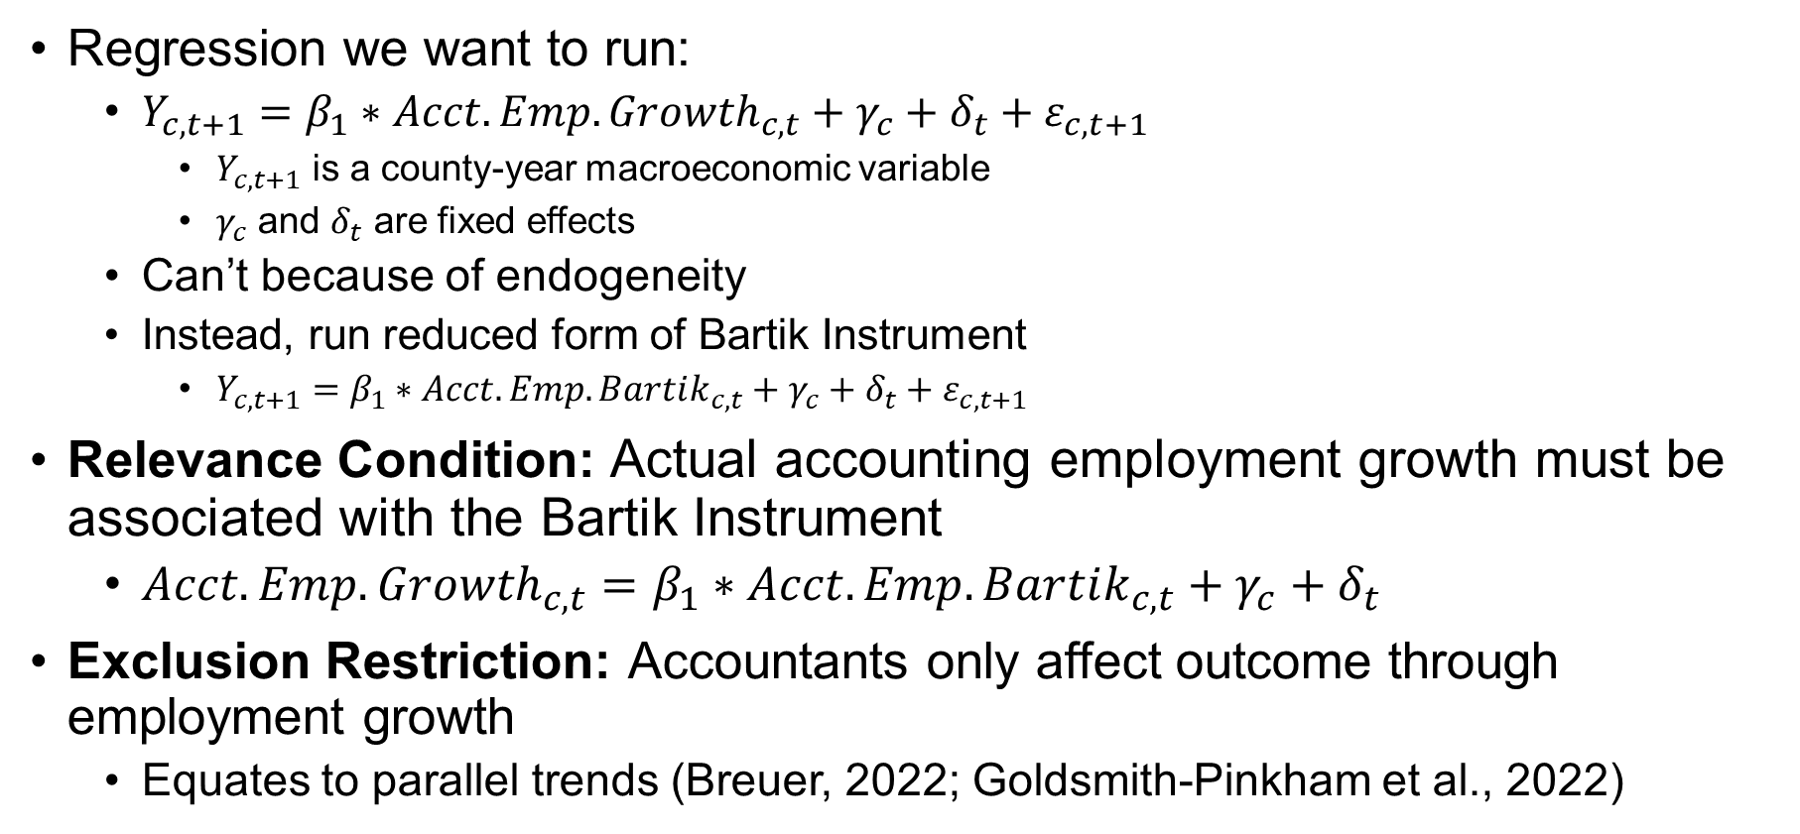
Solution 1: Bartik Instrument
Regression we want to run:
$Y_{c,t+1}=β_{1}∗Acct. Emp. {Growth}_{c,t}+γ_{c}+δ_{t}+ε_{c,t+1}$
$Y_{c,t+1}$ is a county-year macroeconomic variable
$γ_{c}$ and $δ_{t}$ are fixed effects
Can’t because of endogeneity
Instead, run reduced form of Bartik Instrument
$Y_{c,t+1}=β_{1}∗Acct. Emp. Bartik_{c,t}+γ_{c}+δ_{t}+ε_{c,t+1}$
Relevance Condition: Actual accounting employment growth must be associated with the Bartik Instrument
$Acct. Emp. {Growth}_{c,t}=β_{1}∗Acct. Emp. Bartik_{c,t}+γ_{c}+δ_{t}$
Exclusion Restriction: Accountants only affect outcome through employment growth
Equates to parallel trends (Breuer, 2022; Goldsmith-Pinkham et al., 2022)

Slide 12
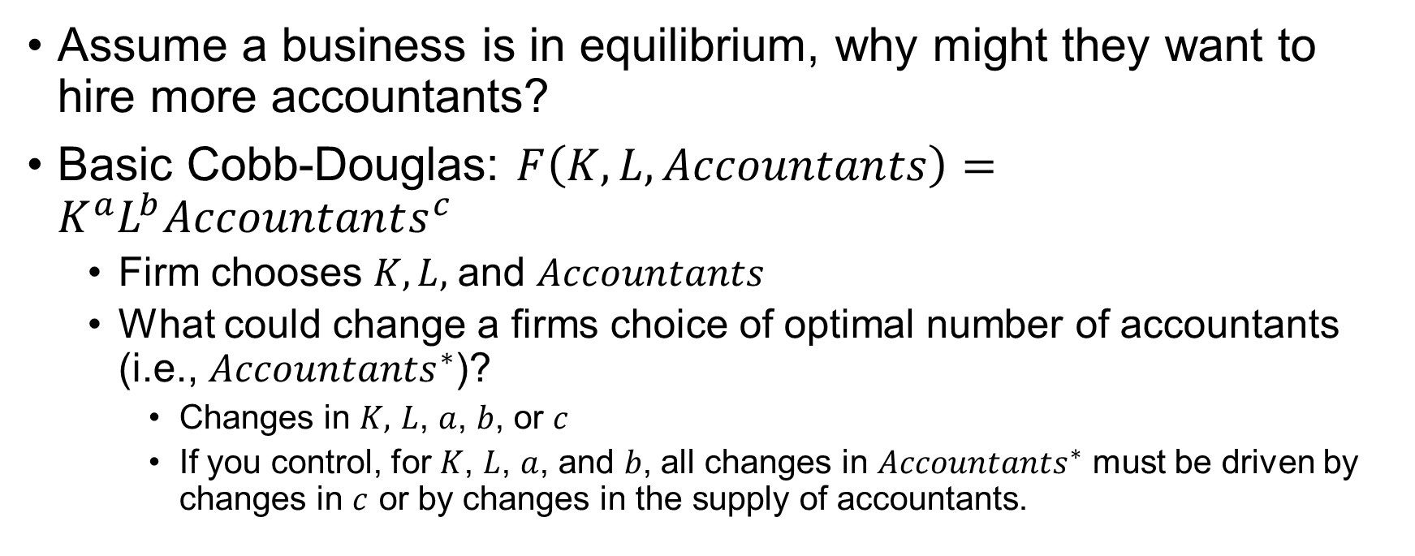
Solution 2: Model
Assume a business is in equilibrium, why might they want to hire more accountants?
Basic Cobb-Douglas: $F\left(K,L,Accountants\right)=K^{a}L^{b}Accountants^{c}$
Firm chooses $K, L,$and $Accountants$
What could change a firms choice of optimal number of accountants (i.e., $Accountants^{∗}$)?
Changes in $K,$ $L$, $a$, $b$, or $c$
If you control, for $K$, $L$, $a$, and $b$, all changes in $Accountants^{∗}$ must be driven by changes in $c$ or by changes in the supply of accountants.

Slide 13
Solution 2: Model
We include controls for capital, labor, materials, services, energy, their respective productivities, and total factor productivity
This likely over-controls for the problem
We include controls for other Bartik Instruments (i.e., total employment, business employment)
Ideally, this implies that changes in the number of accountants must only come from changes in accounting productivity

Slide 14
Lingering Threats
May be controlling for mechanism
Functional form problem with controls
Don’t know true functional form
May be missing a production factor
Cannot conclude that our results are definitively causal, but they are highly suggestive.

Slide 15
Preview of Results
Accountants positively affect economic activity
Counties with higher accountants have higher GDP, employment, establishments, and wages.
How accountants affect economic activity: Accountants are related to
Net job creation.
Net business openings.
Number and total magnitude of small business loans.
Greater investment efficiency.
We document several stylized facts about accounting employment.
Rising accountant employment
Declining relative wages
Key Takeaway:
Accountants positively affect various aspects of aggregate economic activity

Slide 16
Data
Bureau of Labor Statistics (BLS) Occupation Employment and Wage Statistics (OEWS)
Collects information on 830 occupations from over a million establishments.
Provides summary statistics and the Metropolitan Statistical Area (MSA) level.
We validate our descriptive results with official BLS estimates

Slide 17
Accountants Definition
Accountants are defined as “Examine, analyze, and interpret accounting records to prepare financial statements, give advice, or audit and evaluate statements prepared by others. Install or advise on systems of recording costs or other financial and budgetary data.”
Roughly 1% of employees are classified as accountants
Average accountants earns $86,740 per year compared to $61,900 for the average American worker in 2022

Slide 18
Accountants and GDP
Counties with increased accounting employment have higher GDP

Slide 19
Accountants and Employment
Counties with increased accounting employment have higher total employment

Slide 20
Accountants and Establishments
Counties with increased accounting employment have higher establishments

Slide 21
Accountants and Wages
Accounting employment growth increases the average wages of workers, albeit primarily benefiting those in the upper half of the income distribution.

Slide 22
Accountants and Business Dynamics
Counties with increased accounting employment have higher job creation and establishment entry

Slide 23
Accountants and Small Business Loans
Counties with increased accounting employment have higher number and amount of small business loans

Slide 24
Accountants and Investment Efficiency
Increases in the fraction of an industry’s employees who are accountants is associated with increases in investment-q sensitivity

Slide 25
Exclusion Restriction: Parallel Trends

Slide 26
Relevance Condition

Slide 27
Descriptive Stats and Trends

Slide 28
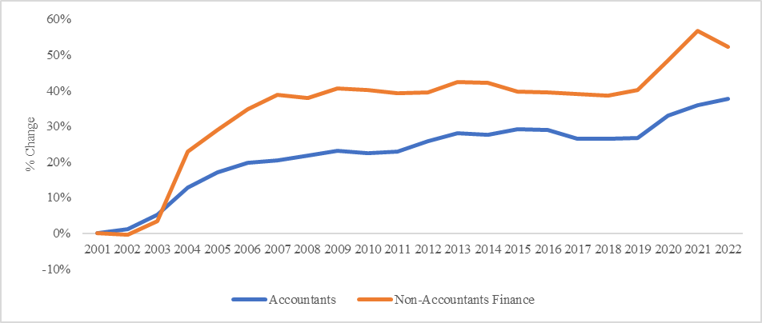
% change in Fraction of US Employees Working as Accountants

Slide 29
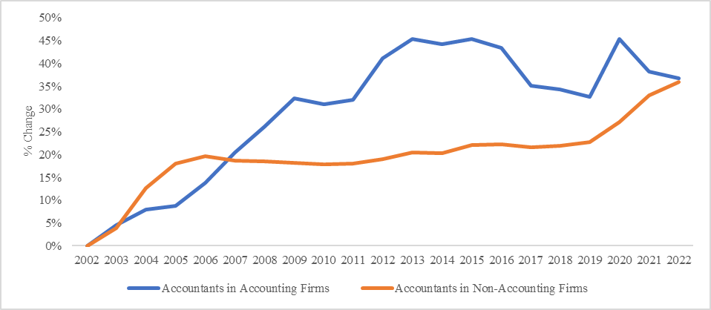
% change in Fraction of US Employees Working as Accountants

Slide 31
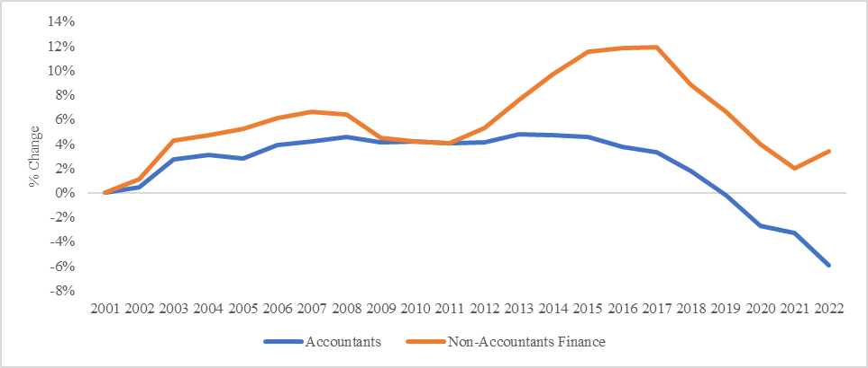
% Change in Accountants Relative Wages

Slide 32
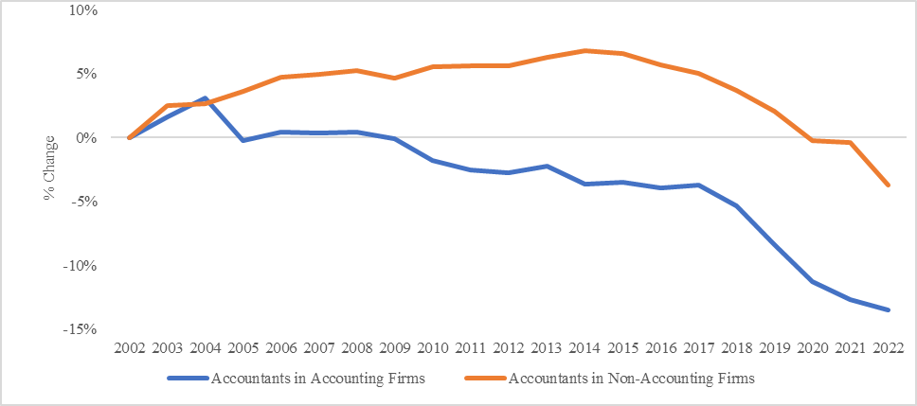
% Change in Accountants Relative Wages

Slide 33
Conclusions
Accountants positively affect economic activity
Counties with higher accountants have higher GDP, employment, establishments, and wages.
How accountants affect economic activity: Accountants are related to
Net job creation.
Net business openings.
Number and total magnitude of small business loans.
Greater investment efficiency.
We document several stylized facts about accounting employment.
Rising accountant employment
Declining relative wages
Key Takeaway:
Accountants positively affect various aspects of aggregate economic activity

Slide 34
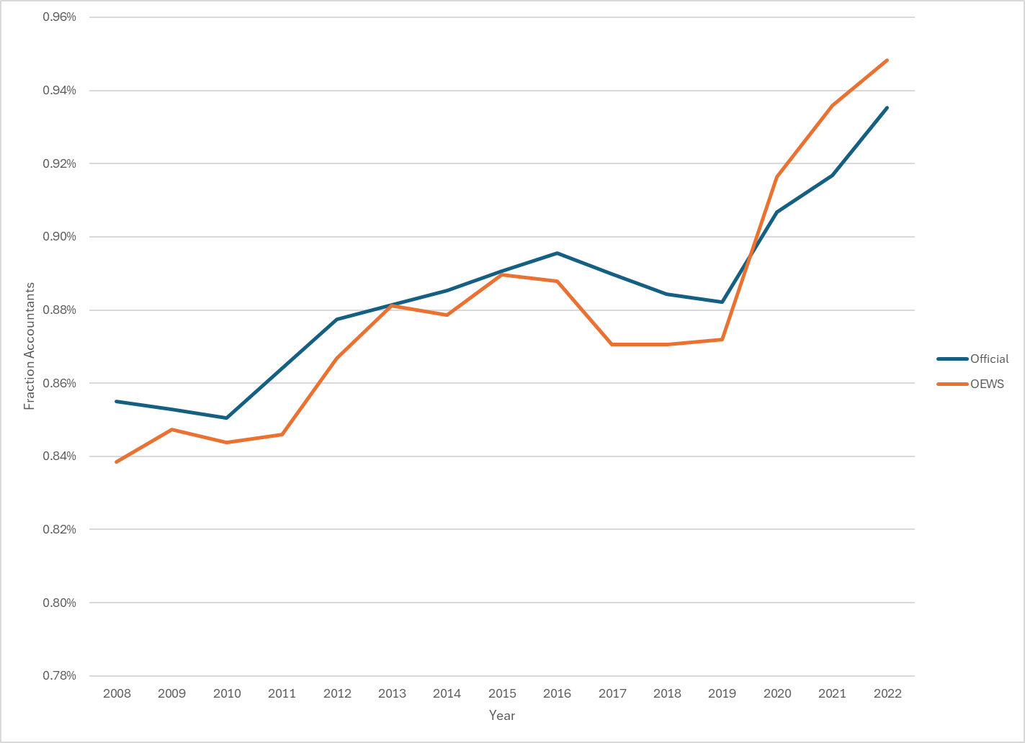
BLS Official Projections

